Slide 1
Progress, challenges and way forward
Building disaster resilient societies

Slide 2
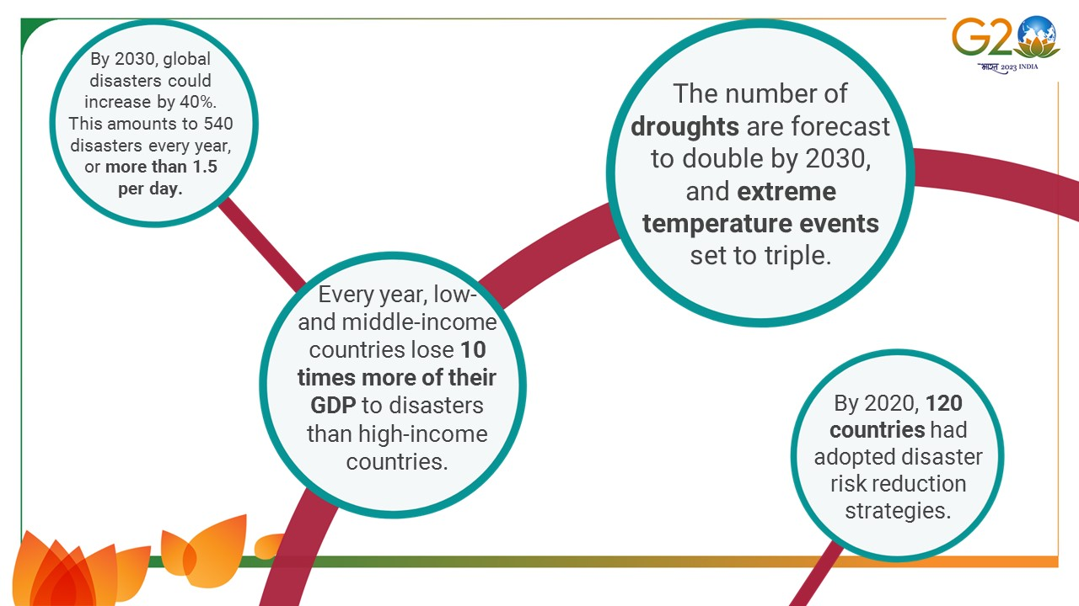
The Current Landscape of disaster risk
Notes:
GAR 2022 states that our world is at risk. In the IPCC AR6 report from Working Group II on Impacts, Adaptation and Vulnerability released earlier this year, climate scientists have warned that we are already perilously close to tipping points that could lead to cascading and irreversible climate impacts. Human decisions on how we live, build, and invest are creating the disaster risks that make our world more dangerous, threaten sustainable development, undermine resilience and our ability to adapt to climate change.
Disasters are rapidly increasing around the world due to climate change and inadequate risk management. Our societal, political and economic choices are contributing to an increase in disasters, with the world set to face 1.5 environmental disasters a day by 2030.
If current trends continue, the number of disasters per year globally may increase from around 400 in 2015 to 540 per year by 2030 – a projected increase of 40% during the lifetime of the Sendai Framework.
For droughts, there is a large year-on-year variation, but current trends indicate a likely increase of more than 30% between 2000 and 2030 (from an average of 16 drought events per year during 2001–2010 to 21 per year by 2030).
The number of extreme temperature events per year is also increasing and based on current trends will almost triple between 2001 and 2030. Disasters have negative impacts on biodiversity and environmental sustainability.
However, these trend lines do not take into account future climate change impacts, which are accelerating the pace and severity of hazard events, nor the fact that current choices mean the world is set to exceed the Paris Agreement’s global average maximum temperature increase target of 1.5°C by the early 2030s.
The average annual direct economic loss from disasters has more than doubled over the past three decades, showing an increase of approximately 145% from an average of around $70 billion in the 1990s to just over $170 billion in the 2010s. That means that every year low-and middle-income countries lose 10 times more of their GDPs to disasters than high income countries.

Slide 3
Status of the Sendai Framework Targets at its Mid-Term
Target | Status
Reduce mortality | Better – decreased, excluding COVID-19
Reduce number of affected persons | Worse - increased by 80%
Reduce direct economic losses | Worse - loss has risen significantly
Reduce damage to infrastructure and disruption to services | Worse - estimated to have doubled
Increase countries with national and local strategies | Better – national strategies increased by 127% to 125 countries
Increase international cooperation | Under-reported
Increase availability of and access to early warning | Low - half of countries lack early warning
Notes:
Target A – Substantially reduce global disaster mortality by 2030:
A decrease per 100,000 people from 1.77 in 2005-2014 to 0.84 in 2012-2021. Improvement in the average annual number of deaths and missing persons in the event of disaster. However, the COVID offset this improvement.
Average annual mortality (2012-2021) is 42,833 people.
Target B – Substantially reduce the number of disaster-affected people globally
The number of persons affected by disasters per 100,000 people has increased from 1,147 in 2005-2014 to 2,066 in 2012-2021.
Average annual number (2015-2021) was 150,214,597 people.
Target C – Reduce direct disaster-related direct economic losses relative to GDP
Average annual direct economic losses (2015-2021) exceed US$ 330 billion – approximately 1% of total GDP of reporting countries. Annual economic loss from climate and weather-related events has risen significantly over the decades.
Target D – Substantially reduce disaster-related critical infrastructure damages and basic services disruptions
142,852 - the average annual number of critical infrastructure units and facilities destroyed or damaged by disasters (2015-2021).
Disasters, including COVID-19 , disrupted over 363,184 basic services in 2021 and 2021.
Target E – Substantially increase national and local disaster risk reduction strategies
The number of countries with national DRR strategies increased from 55 in 2015 to 125 in 2021. 99 countries have reported having local governments with DRR strategies.
Target F – Substantially enhance international cooperation for disaster risk reduction
In the last decade, 42 developing countries reported receiving ODA for national DRR actions, and 26 countries reported providing ODA support. 4.1% of DRR-related ODA (2010-2019) was spent on disaster prevention and preparedness.
Target G – Increase availability and access to early warning systems and risk information
95 out of 120 countries reported the existence of Multi-hazard Early Warning Systems (MHEWS).

Slide 4
Global DRR Challenges: Main findings from the Mid-term Review Process
Global systemic risks, including increasing climate change impacts and recovery from COVID-19 pandemic
Inadequate, often siloed, risk governance and risk management overwhelmed by global catastrophic risks
Risk-informed preventative financing lacking, response versus prevention
Lack of policy and regulatory imperative / incentives for DRR in private sector decision-making
Risk externalized in investments and finance
Short-termism
Unique challenges for LDCs, LLDCs and SIDS, and persons most at risk not adequately addressed
Notes:
The Midterm Review finds that while some progress has been made in realising the outcome and goal of the Sendai Framework since 2015, eight years on we are not where we need to be.
As a result of the collective failure to place risk reduction and prevention at the heart of current societal, political and economic choices – not to mention the global financial system – risk creation is outstripping risk reduction.
Conventional risk governance and risk management approaches are simply not fit-for-purpose for dealing with 21st century risks.
Unless we change course at national and multilateral levels, these will continue to overwhelm us.

Slide 5
Way forward
Shift from investing in response to investing in prevention and risk reduction.
Strengthen risk governance architecture – multiple authorities and organisations take responsibility for preventing and reducing disaster risk at both national and local levels.
Redress how risk features are treated in the financial system; including to accurately price, account for, and disclose disaster risk.
Integrate risk reduction in sustainable development efforts, climate and humanitarian action, and capitalize on opportunities post-disaster to build back better.
Notes:
The Midterm Review recommends strengthening risk governance architecture at all scales – to expand the responsibility for disaster risk reduction, so that multiple authorities and organisations take responsibility for preventing and reducing risk, before it manifests as a shock.
It calls for adopting a multi-hazard and multi-sectoral approach to risk reduction able to deal with the systemic nature of risk. Approaches that encompass natural and human-made hazards, as well as related environmental, technological, and biological hazards and risks.
The Midterm Review calls for a shift from investing in response to investing in prevention, risk reduction and resilience. It calls for an overhaul of how risk and risk reduction is treated within the global financial system, to make supporting disaster risk reduction a core duty, thus incentivising investments in risk reduction and resilience.
It calls for the integration of disaster risk reduction within sustainable development efforts, climate and humanitarian action, and seize opportunities to build back better post-disaster.
These recommendations are fundamentally central to work exploring effective multilateralism, to the evolution of a UN 2.0, to the reform of the global financial system, the work on Future Generations and the SG’s Policy Brief on the Emergency Platform.

Slide 6

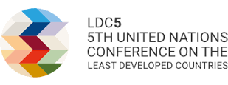

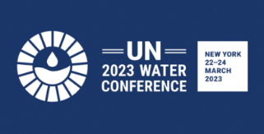
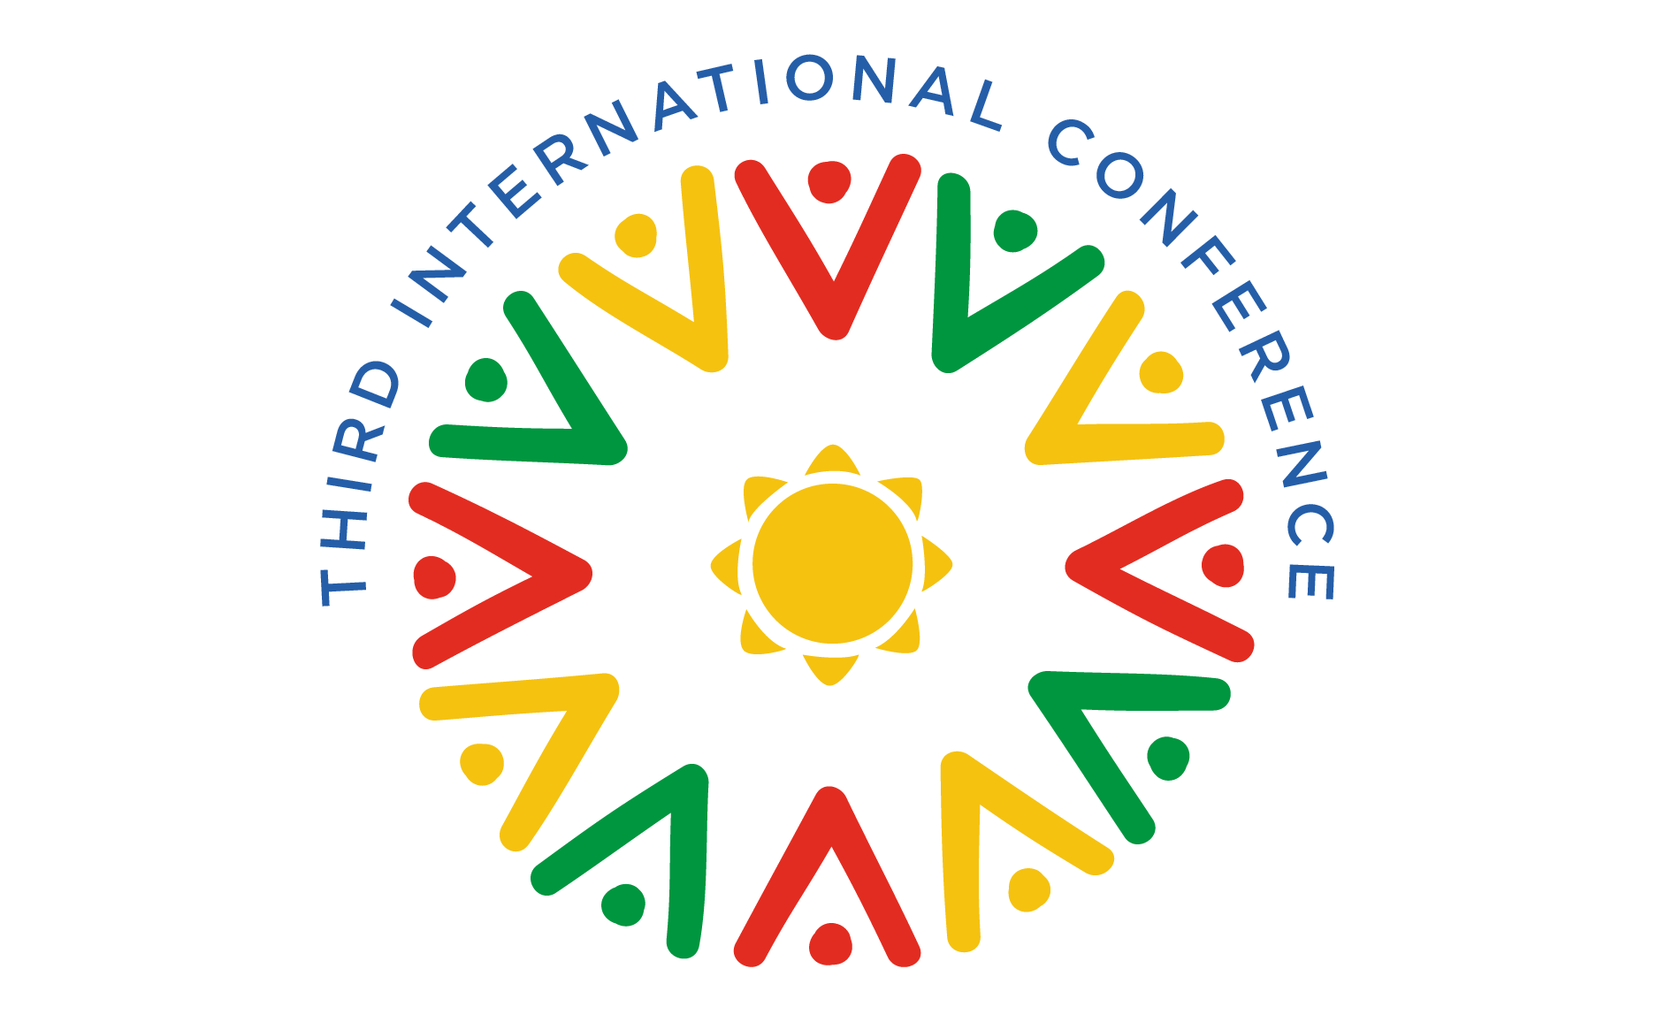

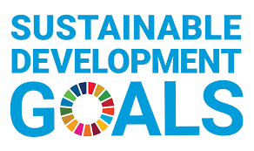
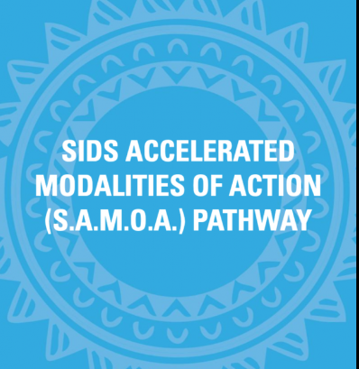
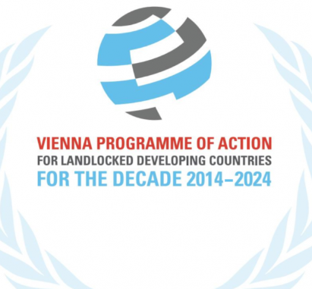


The Opportunity:
Promoting risk-informed and prevention-oriented approaches in 2023, and beyond
Notes:
We need decisive action to prevent and reduce risk and build resilience.
The Midterm Review of the Sendai Framework is one of several reviews taking place in 2023, and it presents the opportunity to drive the recommendations of the MTR SF into the outcomes of, for example:
the UN Water Conference,
the quadrennial review of the SDGs and the SDG Summit,
the HL Dialogue on Financing for Development,
COP28 and the Global Stock Take of the Paris Agreement, and
the follow-up plans and actions to, for example, the Kunming-Montreal Global Biodiversity Framework, the Doha Programme of Action for the LDCs, the Vienna Programme of Action and the SAMOA Pathway.
This will not happen without concerted and sustained support from Member States
Encourage alignment between the reviews of the Sendai Framework and Water Action Decade, addressing the urgent need to reduce water-related risks.
The implementation of the Sendai Framework is critical to the successful achievement of the Water Action Decade and for building resilience. The UN 2023 Water Conference should consider how its deliberations prevent and reduce risks before they manifest as disasters, and how decisions can avoid the creation and propagation of risks across systems.
We encourage delegations to leverage the outcome of the Midterm Review of the Sendai Framework to inform the 2023 SDG Summit, providing practical policy guidance to advance the commitments made at the SDG Summit in 2019.
The outcomes of the MTR SF will offer invaluable insight on the extent to which development is reducing or creating risk, and will provide concrete policy recommendations and actions to be taken forward from the Summit. The SDG Summit and other high-level meetings can shape the future of risk reduction
The High-level Dialogue on Financing for Development is an opportunity to build on existing momentum and call for greater action to deliver on the commitments to finance disaster risk reduction, including resilient infrastructure, build risk-informed investing, and ensure public and private investments in all sectors are risk-informed; as enshrined in the Addis Ababa Action Agenda and Sendai Framework.
It will also be an opportunity to call for the IFIs to integrate risk reduction into their operations.
The MTR SF outcomes can be a bridge across the SDG Summit, COP28 and the HLD on FFD to spotlight innovative solutions to de-risking investments, and risk-informed sustainable development.
COP28: The MTR SF will provide important insight and data for the Paris Stock Take related to loss and damage, adaptation, and comprehensive risk management. Building on COP27 and the Sharm el Sheikh Implementation Plan, this will be a critical opportunity for a strong message on risk informed (including climate risk) development.
The Summit of the Future is another opportune moment to accelerate Sendai Framework implementation through its integration in development policy and action including through strengthening capacities for foresight and futures literacy.
The lessons learnt from the COVID-19 pandemic for strengthened coordination, coherence and integration between disaster and health risk management systems will be critical in the deliberations at the High-level meetings on Universal Health Coverage and Pandemic Prevention, Preparedness and Response.
The least developed countries, landlocked developing countries and small island developing States continue to face numerous resource and capacity challenges that limit the implementation of their commitment to disaster risk reduction.
The Doha Programme of Action reflects significant advances towards a risk-informed approach to development.
The inclusion of DRR in the successor frameworks to the SAMOA Pathway and Vienna Programme of Action can turbocharge development in these groups of countries. The findings of the MTR SF can help identify SIDS and LLDC-specific priorities and policy guidance for risk-informed development.
The regional review meetings in 2023 are critical opportunities to promote DRR inclusion and ensure coherence with the implementation and monitoring of the Sendai Framework.

Slide 7
Thank you!

